Slide 1
Media Queries
Spencer Powell

Slide 2
What are media queries?
Media queries are used to make adjustments to your site based on specific characteristics of the users device (resolution, browser, viewport height, etc).
They can also be used based on different media types (print, screen, speech, or all)

Slide 3
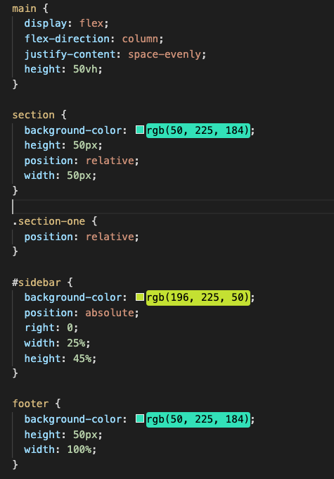
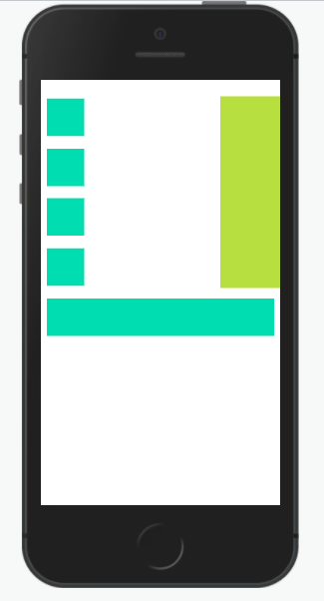

Slide 4
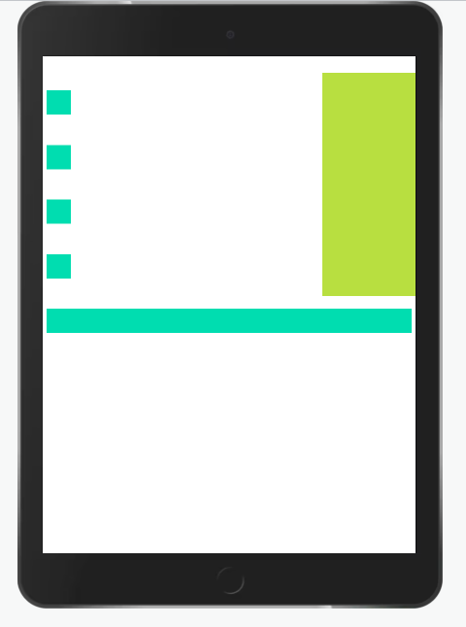

Slide 5
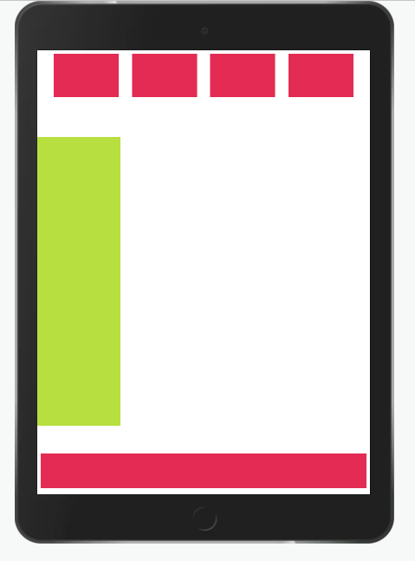

Slide 6
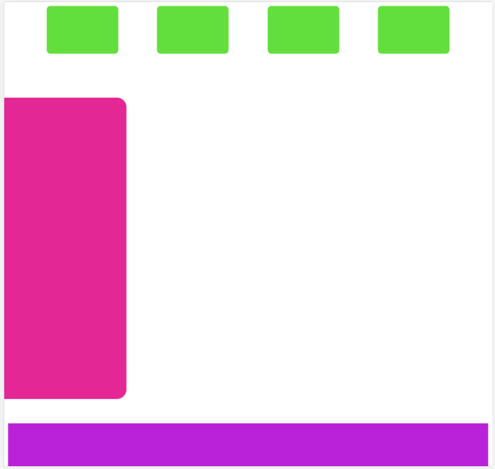

Slide 7
What makes up a media query?
A media query is made up of 4 different parts
Starts with ‘@media’
Media Type
Media Features
Operators (optional)
EX 1. @media screen (min-width: 300px) {}
EX 2. @media screen (min-width: 300px) and (max-width: 800px) {}

Slide 8
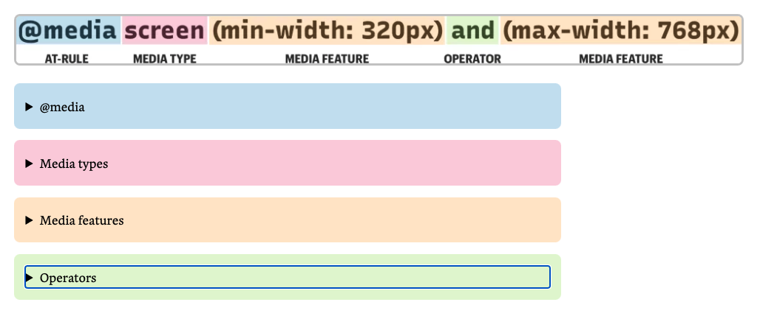
https://css-tricks.com/a-complete-guide-to-css-media-queries/

Slide 9
Where can we use media queries?
Media queries are often associated with CSS but
They can also be used in HTML and Javascript

